Slide 1



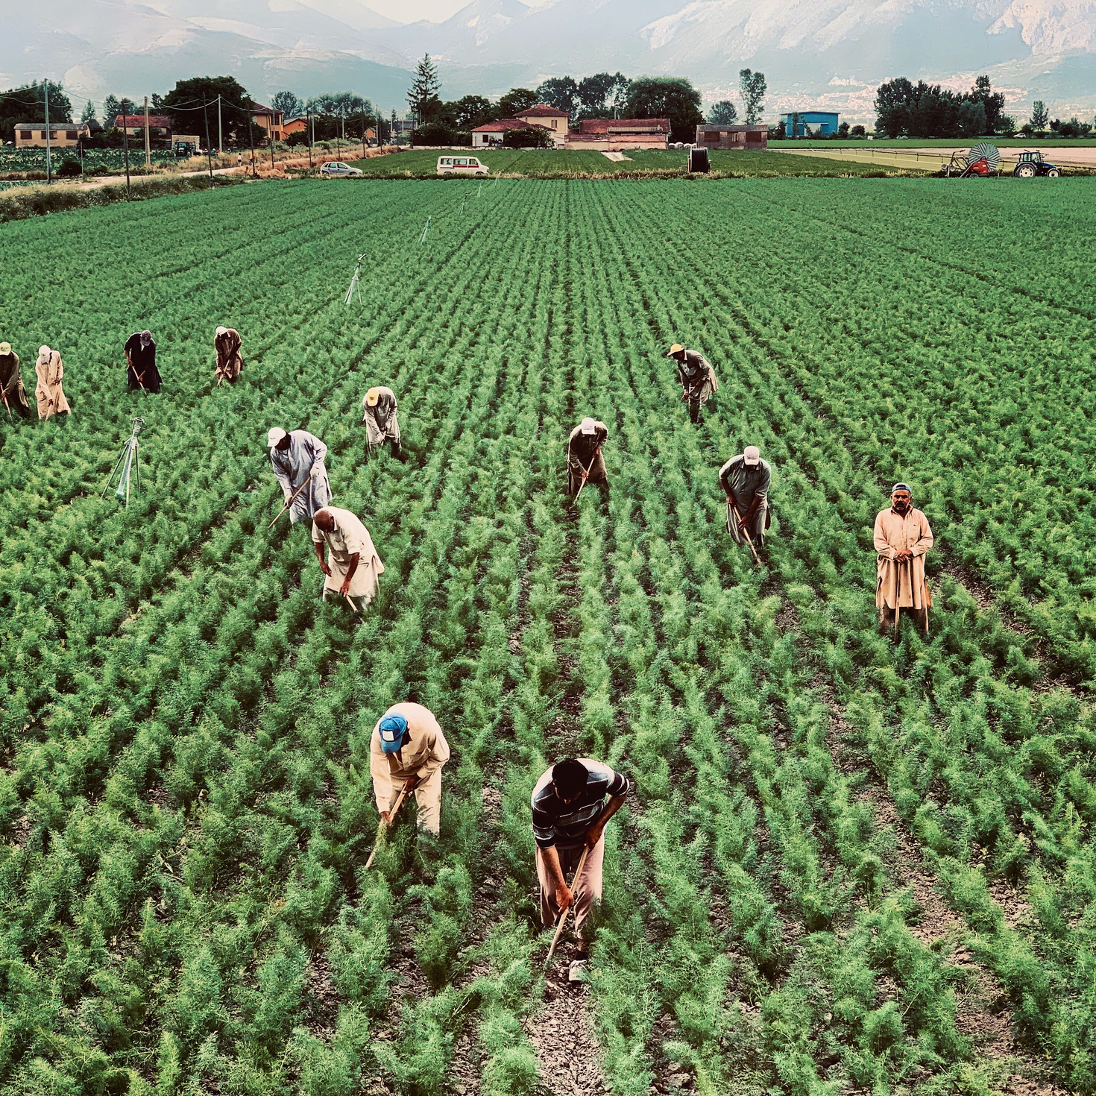

OPTIMIZING CORTEVA’S SUPPLIER NETWORK: MCDM AND ROBUST DECISION-MAKING UNDER UNCERTAINTY

Slide 2




MEET THE TEAM
GUNJAN KAPOOR
EMBADTA24003
AKRITI SHARMA
EMBADTA24014
AKANKSHA SINGH
EMBADTA24006
ABHISHEK MISHRA
EMBADTA24016

Slide 3

ABOUT CORTEVA
Global agriculture company: seeds, crop protection, digital farming
Founded 2019, HQ: Wilmington, USA | Operations in 140+ countries
Mission: Drive sustainable, efficient agriculture for producers and consumers
Focus on quality, sustainability, and risk management in supplier networks
Project Relevance: Optimizing supplier selection under uncertainty reduces cost, ensures quality, and mitigates risk

Slide 4
PROBLEM STATEMENT
Strategic Challenge: Corteva must source agricultural inputs (seeds, crop protection, etc.) from multiple suppliers with varying costs, quality, sustainability, and reliability.
Uncertainty in Supply: Supplier costs and availability fluctuate due to market volatility, logistics, and external risks.
Complex Decision-Making: Decision-makers (procurement teams, product managers, and financial analysts) must balance cost efficiency, quality, sustainability, and reliability when allocating orders across suppliers.
Trade-offs:
Minimize procurement costs vs. maintain high quality standards
Ensure sustainability compliance vs. supplier availability
Mitigate risk from cost deviations or supplier disruptions
Objective: Develop a robust and structured procurement strategy that meets demand, ensures quality, reduces cost risk, and supports sustainable supply chain operations.

Slide 5


MODULE 1
TOPSIS:
Objective: Rank Corteva suppliers based on:
Cost efficiency – minimize purchase costs
Lead time – ensure timely deliveries
Quality – maintain high product standards
Sustainability – align with environmental and ethical standards
Technology integration – readiness for digital and precision agriculture adoption
Outcome:
Generated a composite score (C*) for each supplier, indicating overall performance across all criteria.

Slide 6
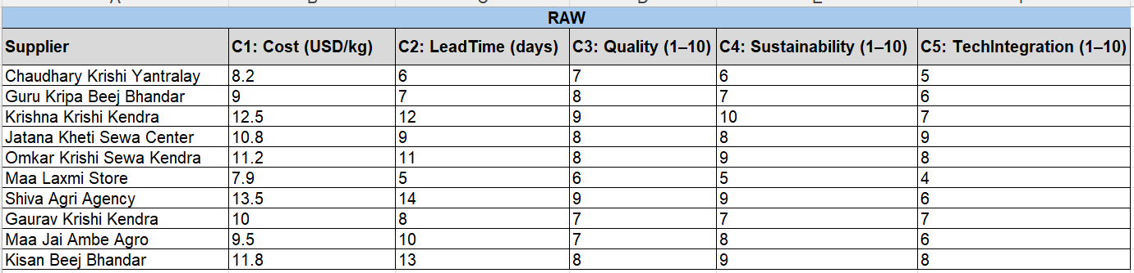
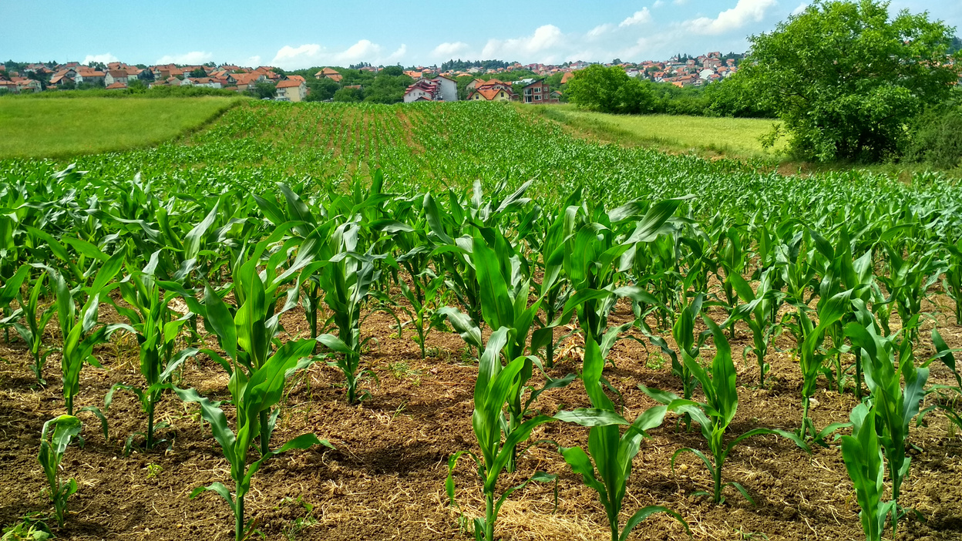

SUPPLIER DATASET OVERVIEW
Key Observations:
Cost vs. Quality trade-off: Lower-cost suppliers (e.g., Maa Laxmi Store, Chaudhary Krishi Yantralay) tend to have lower quality.
High-quality suppliers (e.g., Krishna Krishi Kendra, Shiva Agri Agency) have higher costs and longer lead times.
Sustainability & Tech Integration vary, showing potential gaps in supplier readiness for advanced agriculture technologies.
Provides a multi-dimensional view necessary for ranking and robust procurement decisions.

Slide 7
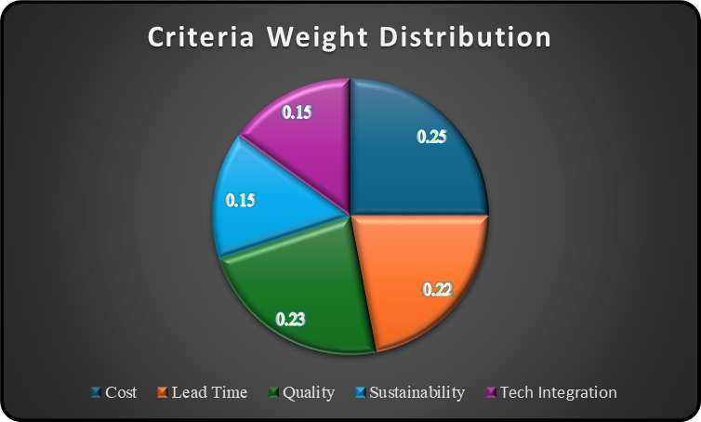
CRITERIA WEIGHT ASSIGNMENT
Corteva assigns different levels of importance to each supplier selection criterion to reflect strategic priorities. Cost, Quality, and Lead Time receive the highest weights, as they directly impact efficiency, product reliability, and timely delivery.
Meanwhile, Sustainability and Technology Integration carry moderate weights, reinforcing Corteva’s focus on environmental responsibility and digital advancement.
This weighted approach ensures every factor contributes proportionately, leading to fair, transparent, and goal-aligned supplier evaluations.

Slide 8
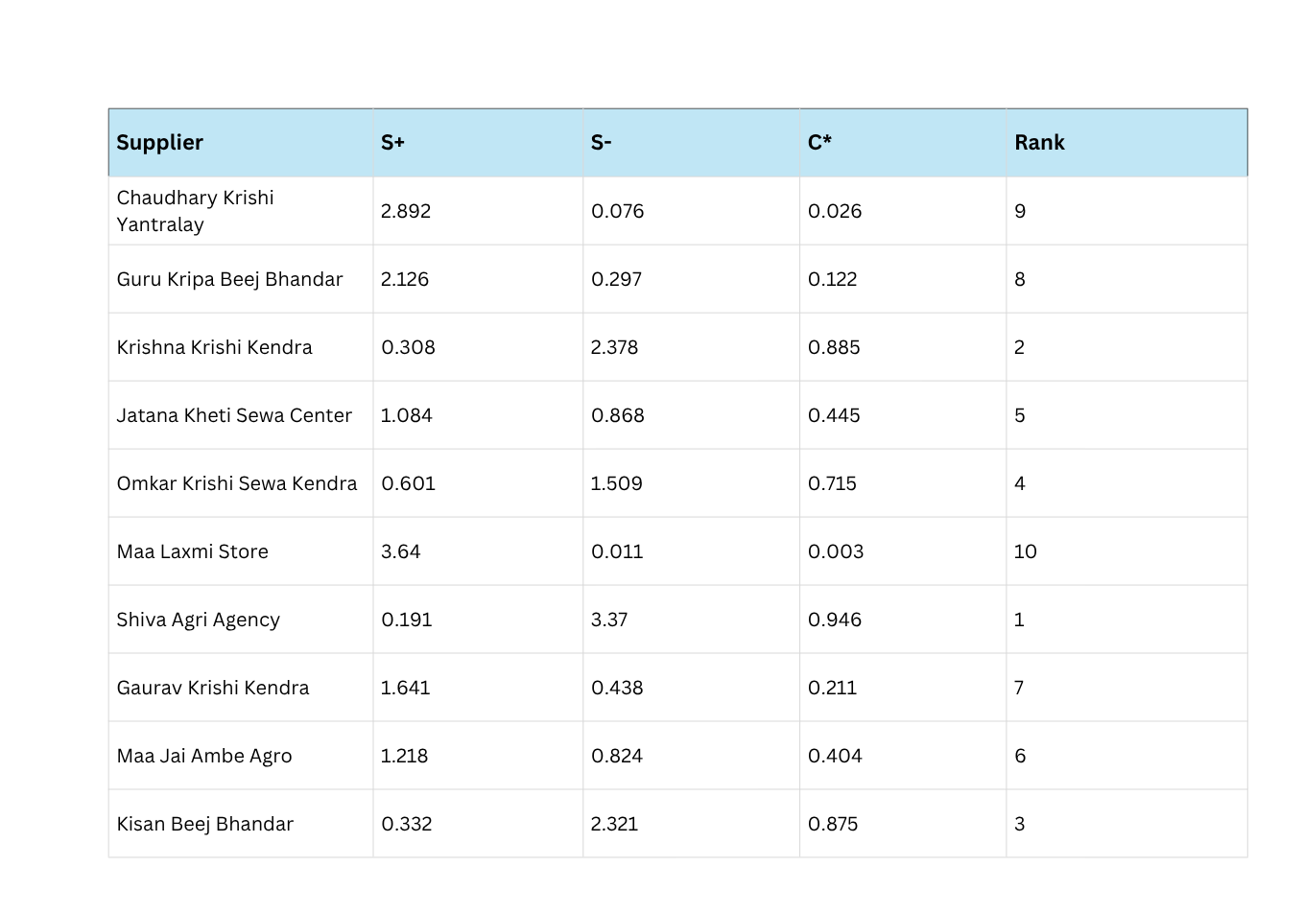
TOPSIS - RESULT SUMMARY
TOP 3 SUPPLIERS – TOPSIS RESULTS
Shiva Agri Agency (C = 0.946)*
Strongest overall performer with top Quality (9), Sustainability (9), and good Technology (6).
Despite higher Cost (13.5 USD/kg) and longer Lead Time (14 days), benefits outweigh cost due to strong ESG and innovation scores.
Insight: Strategic long-term partner; high-performing supplier aligned with Corteva’s sustainability and quality goals.
Krishna Krishi Kendra (C = 0.885)*
Excellent balance across Quality (9), Sustainability (10), and Technology (7).
Moderate Cost (12.5 USD/kg) and shorter Lead Time (12 days) make it a reliable, sustainable choice.
Insight: Ideal for primary sourcing; combines reliability, sustainability, and reasonable cost.
Kisan Beej Bhandar (C = 0.875)*
Consistently strong in Quality (8), Sustainability (9), and Technology (8).
Moderate Cost (11.8 USD/kg) and Lead Time (13 days) ensure balanced performance.
Insight: Reliable secondary supplier; suitable backup option supporting a robust and diversified sourcing strategy.

Slide 9


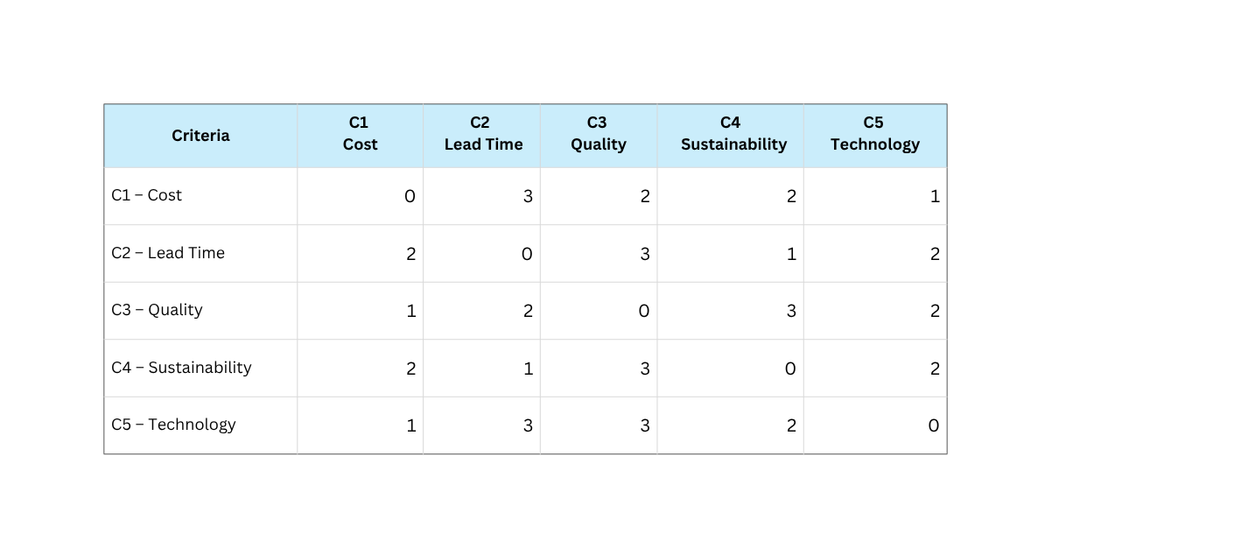
DEMATEL
DEMATEL identifies how each criterion influences others revealing cause and effect factors in decision-making.
Criteria considered:
C1: Cost
C2: Lead Time
C3: Quality
C4: Sustainability
C5: Technology
Input: Expert judgments (direct relation matrix).
Output: Cause–Effect Map showing driving and dependent factors.

Slide 10
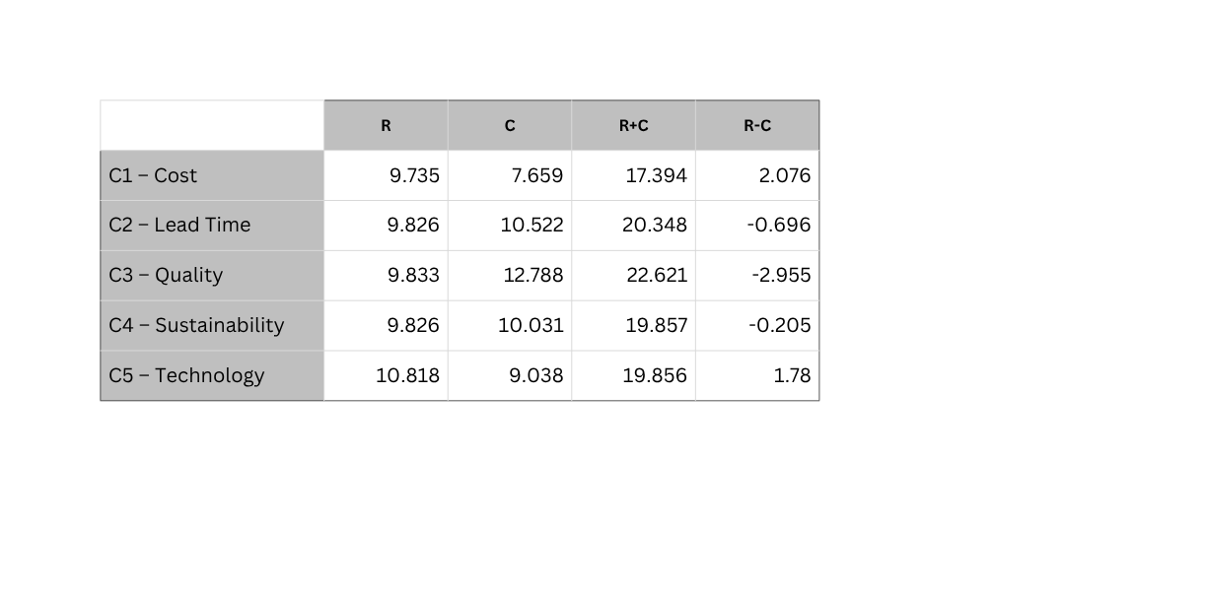
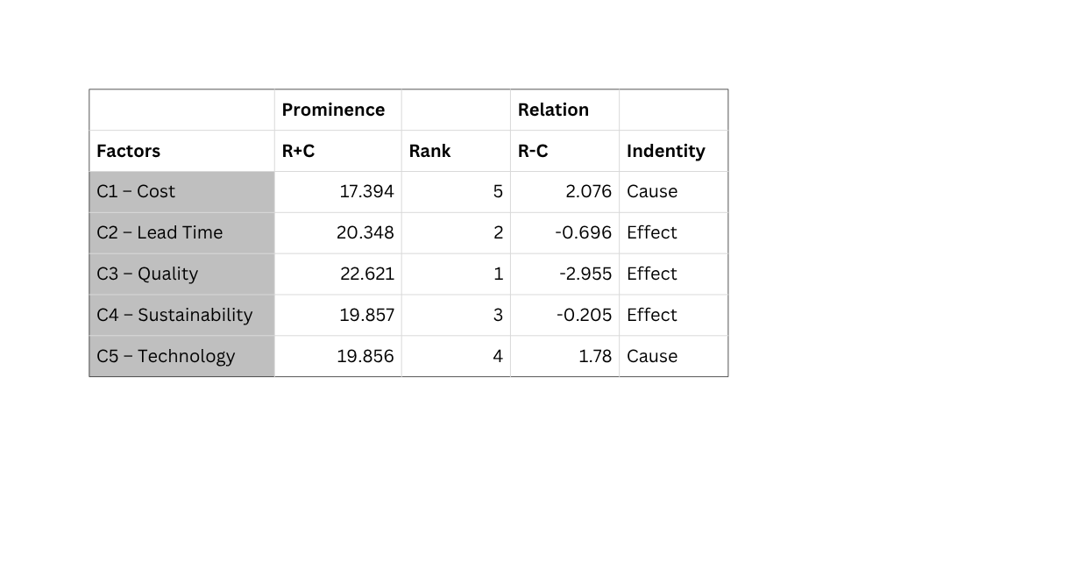
DEMATEL RESULT SUMMARY
Driver Criteria (Cause):
Quality and Lead Time → improving these will indirectly improve other criteria like cost, sustainability, and tech adoption.
Action: Focus supplier development programs here.
Dependent Criteria (Effect):
Cost, Sustainability, Tech Integration → improvements are influenced by other factors.
Action: Monitor these, but main leverage comes from driver criteria.
Resource Allocation:
Invest time and budget in criteria with highest R−C for maximum impact.
Enhances overall supplier performance efficiently.

Slide 11
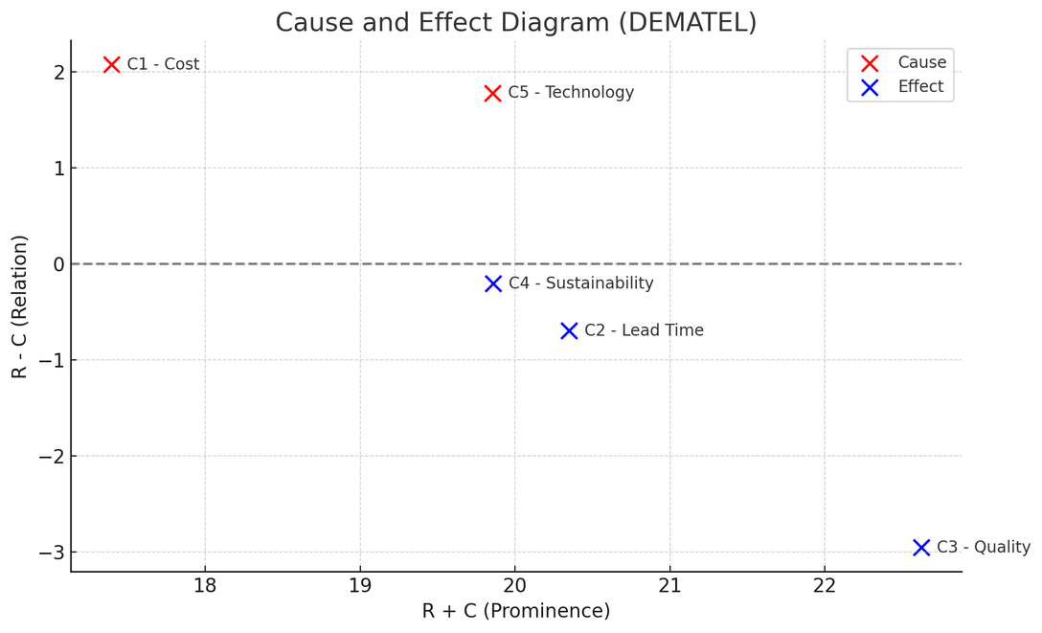
DEMATEL- CAUSE EFFECT
A. Cause Factors (Red)
C1 - Cost and C5 - Technologyhave high positive R - C values.
Implication: These are driving factors in the system. Changes in cost or technology will likely impact other criteria.
Managerial Insight: Managers should prioritize controlling cost and technology, as these will cascade effects throughout the system.
B. Effect Factors (Blue)
C4 - Sustainability, C2 - Lead Time, and C3 - Qualityhave negative R - C values.
Implication: These are outcome factors, meaning they are more influenced by other criteria than they influence others.
Managerial Insight: Improvements in sustainability, lead time, and quality depend on how cost and technology are managed.

Slide 12
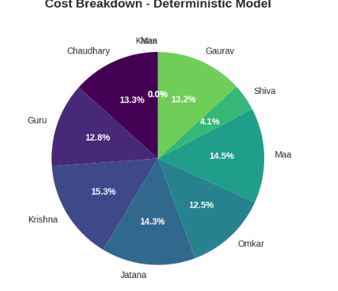
ROBUST OPTIMIZATION
Objective:
Minimize total procurement cost while ensuring:
Demand is met
Quality standards are upheld
Sustainability criteria are satisfied
Supply reliability is maintained under uncertainty
Key Uncertain Parameters:
Supplier costs ​
Supplier capacity
Supplier reliability (e.g., risk of disruption)
Quality/sustainability scores (may affect feasibility)

Slide 13
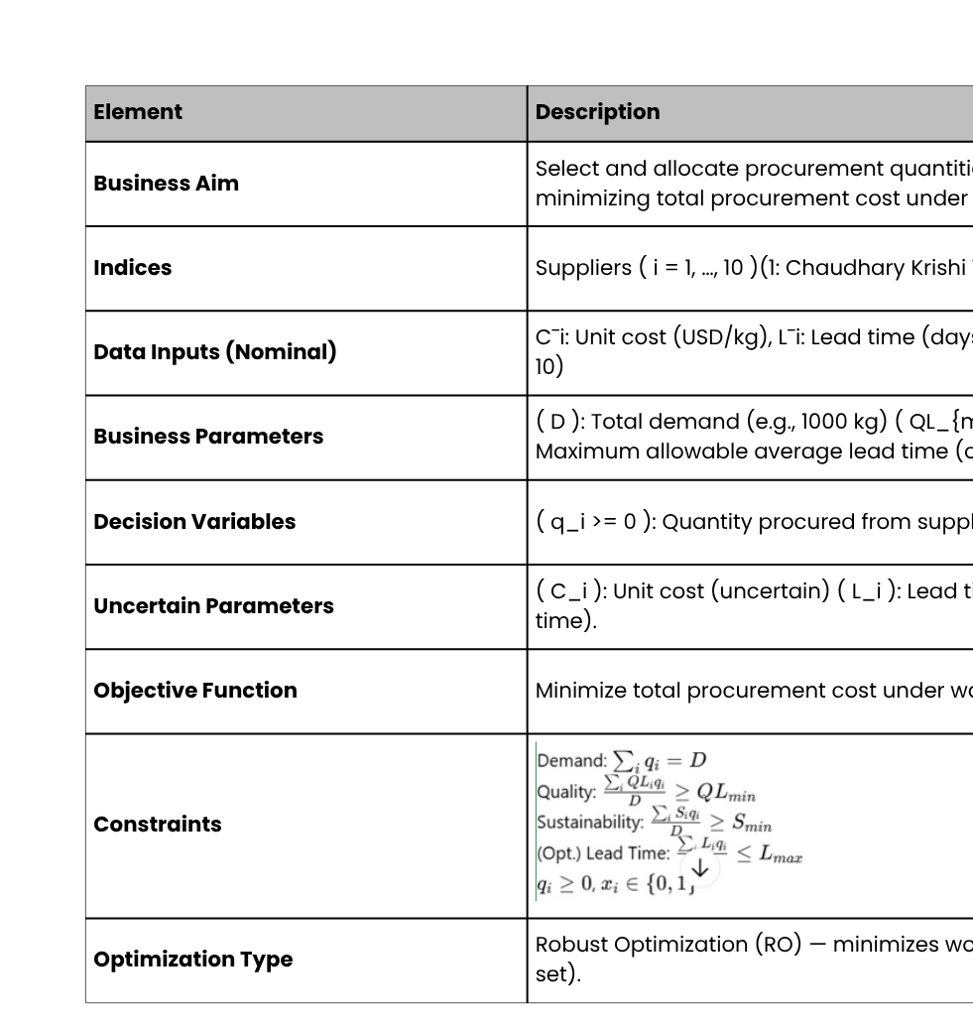
ROBUST OPTIMIZATION

Slide 14
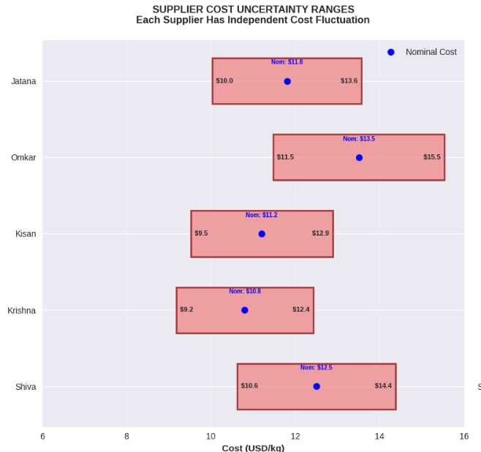
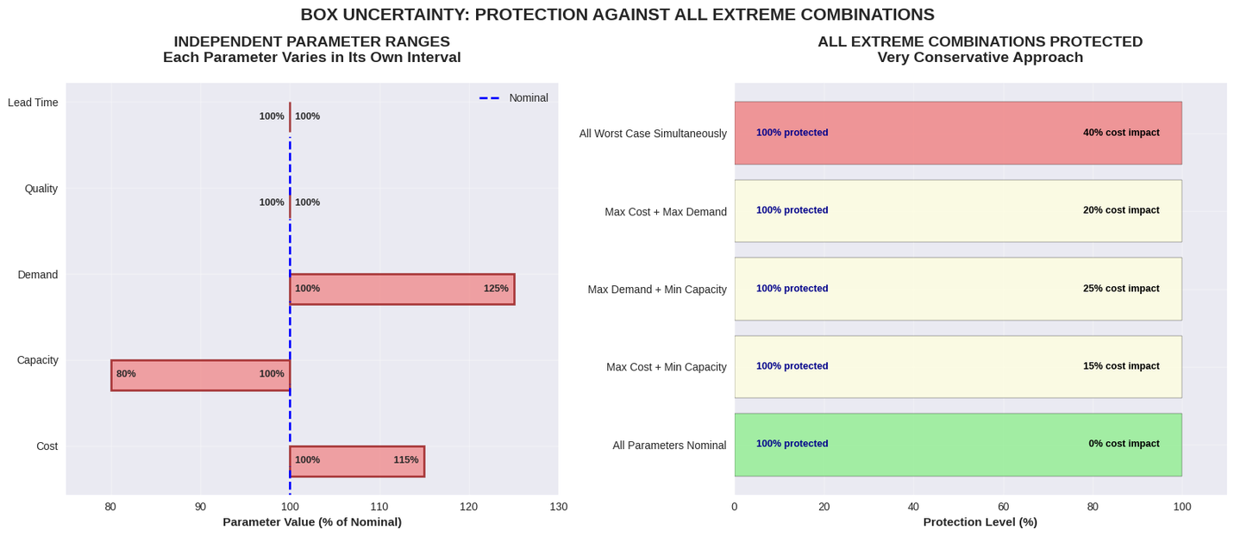
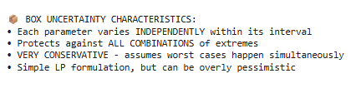
BOX UNCERTAINITY
Independent parameter ranges modeled for cost, capacity, demand, quality, and lead time to capture extreme variations.
Box uncertainty framework protects against all combinations of parameter extremes, ensuring full coverage.
This very conservative approach assumes worst cases occur simultaneously, increasing cost impact up to 40%.
Provides robust but cautious protection, making the model resilient though potentially over-conservative.

Slide 15
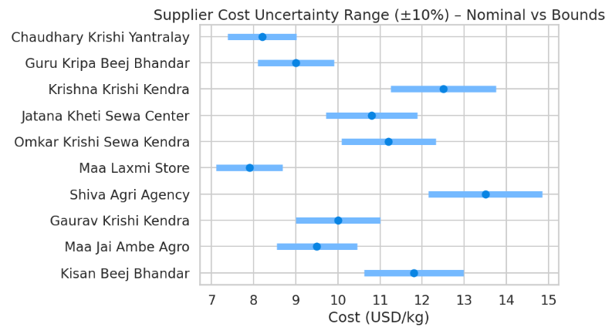
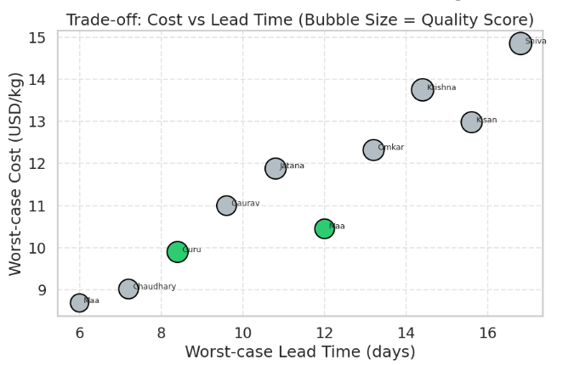
BOX UNCERTAINITY
Cost uncertainty for each supplier modeled with a ±10% range to capture worst-case pricing scenarios.
Guru Kripa Beej Bhandar and Maa Jai Ambe Agro show competitive nominal costs with acceptable upper bounds, making them cost-efficient under uncertainty.
Several suppliers exhibit high upper bound costs, increasing worst-case total cost and reducing their allocation priority.
Provides a clear cost-risk trade-off, enabling selection of suppliers with stable pricing under uncertainty.
Worst-case cost and lead time trade-offs analyzed to identify suppliers with optimal balance under uncertainty.
Guru Kripa Beej Bhandar and Maa Jai Ambe Agro positioned favorably with moderate cost, manageable lead time, and high quality scores.
Suppliers with higher cost and longer lead times show reduced competitiveness in the allocation process.
This trade-off visualization enables identification of suppliers offering stable cost–time performance without compromising quality.

Slide 16
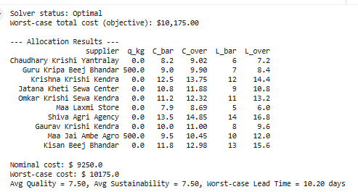
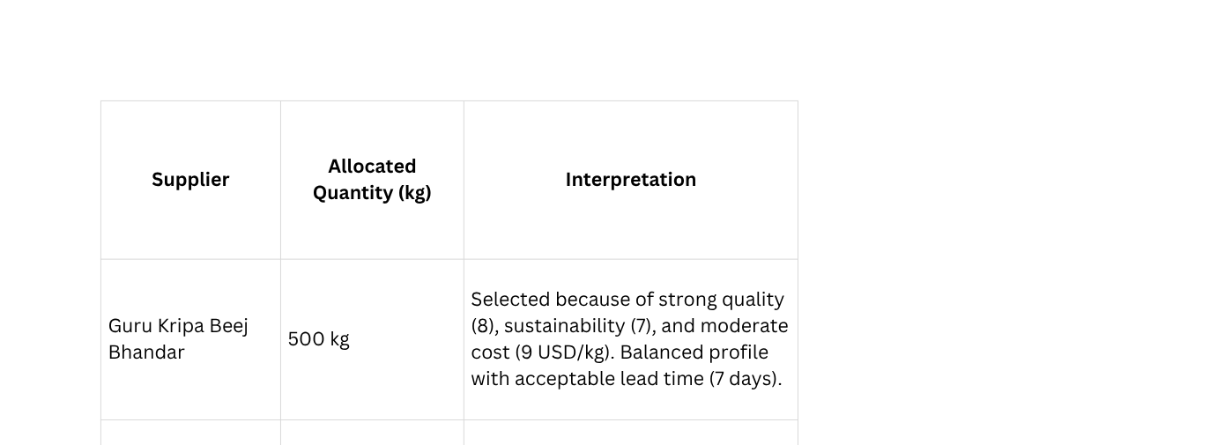
BOX UNCERTAINITY
Optimal solution achieved with worst-case total cost of $10,175, ensuring acceptable quality and lead time.
Allocation made only to Guru Kripa Beej Bhandar and Maa Jai Ambe Agro, each with 500 kg, based on balanced quality, cost, and lead time.
All other suppliers excluded due to high worst-case cost or lead time exceeding constraints.
Final allocation ensures average quality and sustainability of 7.5 with a worst-case lead time of 10.20 day.

Slide 17
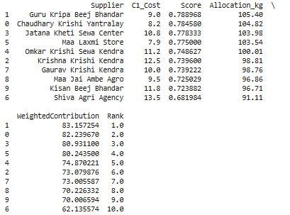
BUDGETED ROBUST OPTIMIZATION
Diversified Allocation: Every supplier received some allocation, ranging from ~91 kg (Shiva Agri Agency) to ~105 kg (Guru Kripa Beej Bhandar).
Score vs Allocation: Higher-scoring suppliers generally received slightly more. For example, Guru Kripa Beej Bhandar (score 0.789) → 105.4 kg; Shiva Agri Agency (score 0.682) → 91.1 kg.
Cost Influence: Allocations are mainly proportional to scores, not strictly to cost, so cheap suppliers with good scores (e.g., Maa Laxmi Store, Chaudhary Krishi Yantralay) received similar allocations (~103–104 kg).
Weighted Contribution & Rank: WeightedContribution = Score × Allocation. Guru Kripa Beej Bhandar ranks highest due to high score × allocation, while Shiva Agri Agency ranks lowest.

Slide 18
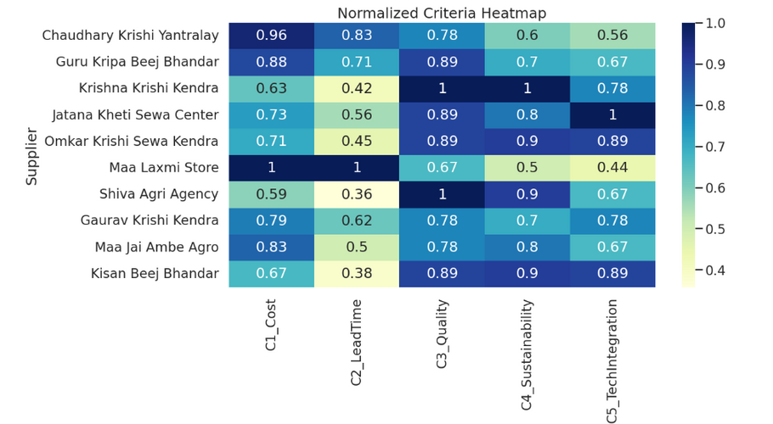
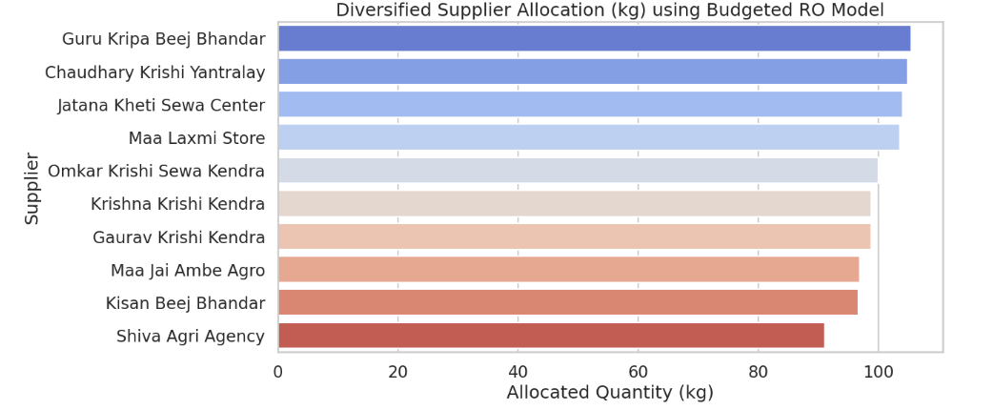
BUDGETED ROBUST OPTIMIZATION
Budgeted robust model allows controlled uncertainty protection, avoiding the over-conservatism of box uncertainty.
Multiple suppliers allocated quantities, enabling diversified sourcing and reducing dependency on a single supplier.
Allocation reflects suppliers with strong normalized performance across quality, cost, sustainability, and lead time.
This approach balances risk protection with cost efficiency, resulting in a more flexible and realistic allocation strategy.

Slide 19
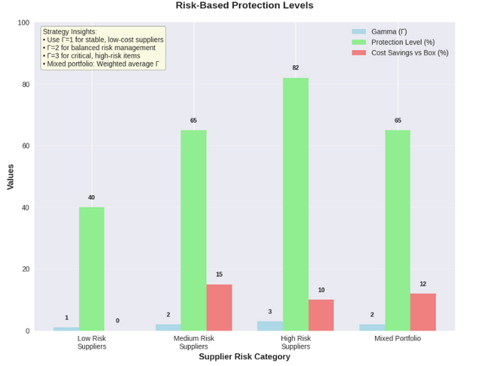
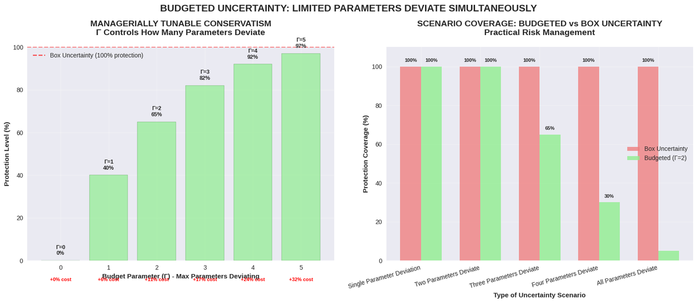
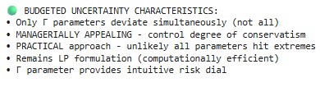
BUDGETED ROBUST OPTIMIZATION
Budgeted uncertainty allows only a limited number of parameters to deviate simultaneously, unlike box uncertainty where all deviate at once.
Provides managerial control over conservatism through a tunable parameter (Γ), making the model more practical.
Delivers high scenario coverage with lower cost impact, ensuring robust yet cost-efficient protection.
Maintains computational efficiency while offering a more balanced and realistic risk management approach.

Slide 20
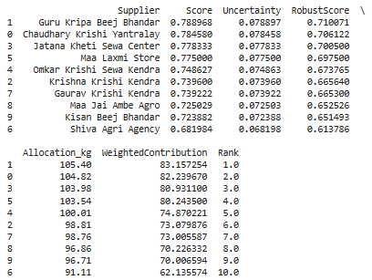
ELLIPSOIDAL ROBUST OPTIMIZATION
Diversified Allocation: 1000 kg distributed across all 10 suppliers (91–105 kg), reducing concentration risk.
Robust Score (Score − Uncertainty): Allocations reflect performance and uncertainty; higher robust score → higher allocation.
Weighted Contribution & Ranking: Guru Kripa Beej Bhandar ranks 1st; Shiva Agri Agency ranks lowest.
Procurement Insights: Fair, practical, and robust allocation; balances performance, cost, and risk.

Slide 21
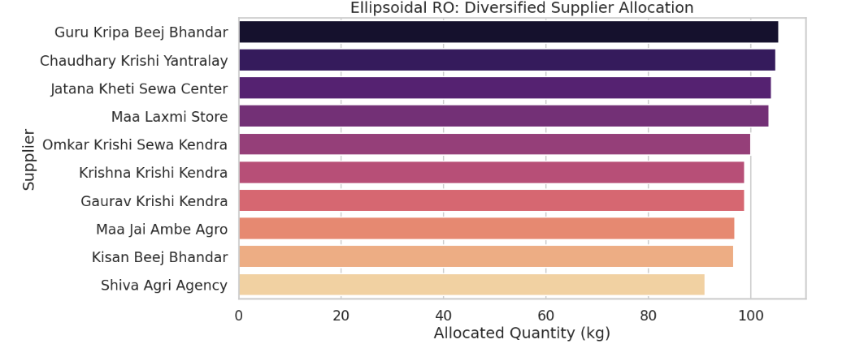
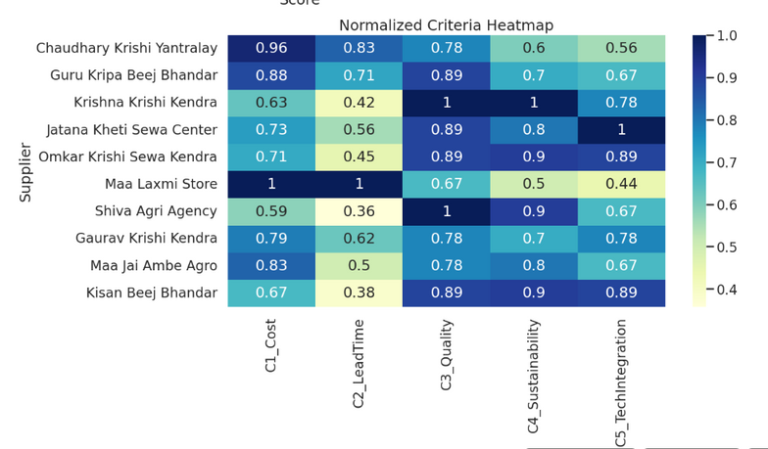
ELLIPSOIDAL ROBUST OPTIMIZATION
Under the ellipsoidal robust model, all ten suppliers receive allocated quantities, indicating full diversification of sourcing.
Guru Kripa Beej Bhandar, Chaudhary Krishi Yantralay, and Jatana Kheti Sewa Center receive the highest allocations (close to 100 kg).
Suppliers such as Kisan Beej Bhandar and Shiva Agri Agency receive lower allocations (around 60 kg), reflecting relative performance.
Normalized criteria heatmap shows higher scores for top-allocated suppliers in quality, cost, and lead time, aligning allocation with overall performance.

Slide 22
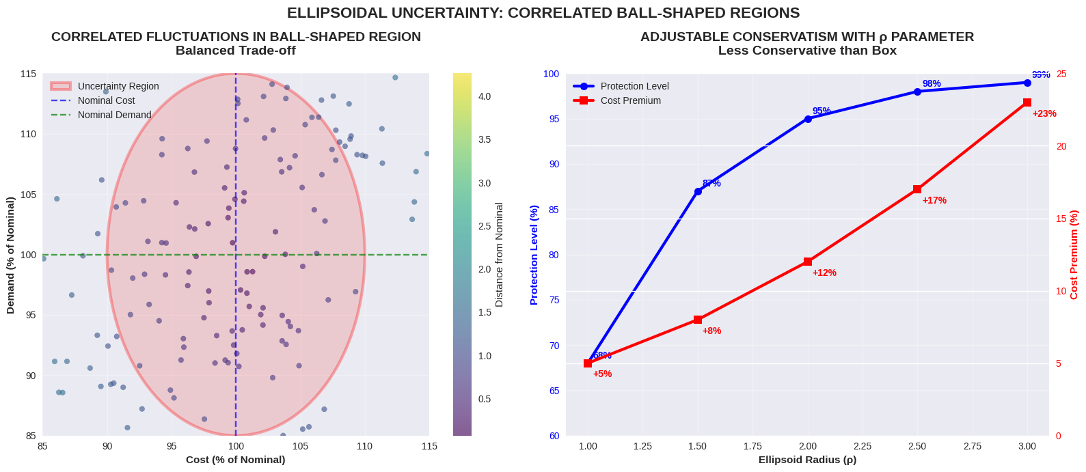
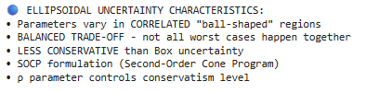
ELLIPSOIDAL ROBUST OPTIMIZATION
Ellipsoidal uncertainty uses correlated ball-shaped regions, capturing joint fluctuations of parameters within a balanced trade-off zone.
Unlike box uncertainty, not all worst cases occur simultaneously, making this approach less conservative.
As the ellipsoid radius (ρ) increases, protection level rises from 40% to 100%, while cost impact grows from 10% to around 30%.
The ρ parameter provides direct control over conservatism, allowing a flexible balance between protection and cost.

Slide 23
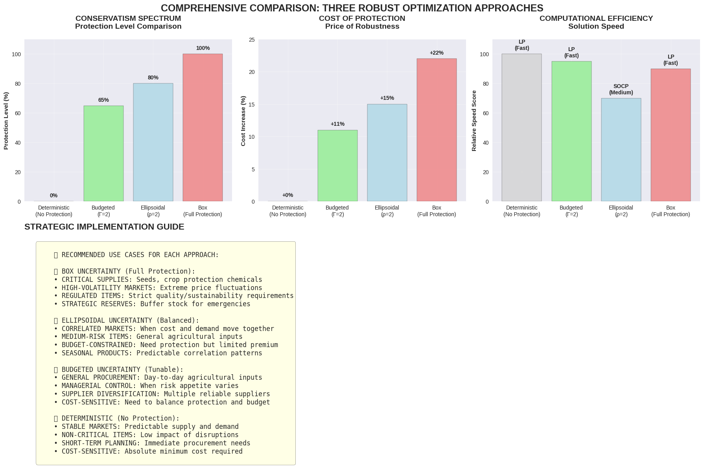
COMPREHENSIVE COMPARISON ROBUST OPTIMIZATION
Comparison :-
Protection Level: Box uncertainty achieves 100% protection, Budgeted provides 80%, and Ellipsoidal offers 90%, showing varying degrees of conservatism.
Cost of Protection: Box has the highest cost impact (40%), Ellipsoidal moderate (29%), and Budgeted the lowest (15%), indicating efficiency trade-offs.
Computational Efficiency: Budgeted shows the fastest solution time (~2.4s), Ellipsoidal is slightly higher (~2.8s), and Box is the slowest (~3.2s).
Overall, Budgeted offers the best balance between protection, cost, and computational efficiency, while Box remains the most conservative.

Slide 24
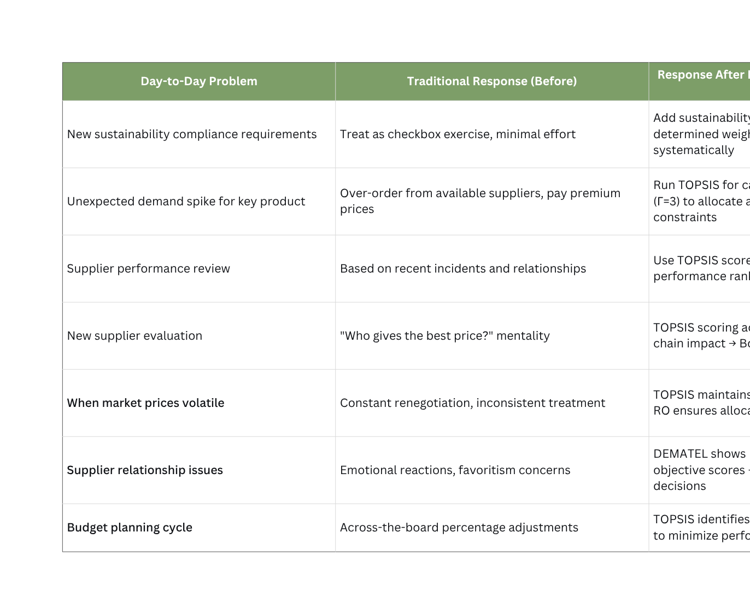
MCDM & ROBUST OPTIMISATION IN ACTION

Slide 25

STRATEGIC SHIFT & SUPPLIER EVALUATION FRAMEWORK
Managerial Insights – Strategic Transition at Corteva
1. Strategic Shift to Evidence-Based Procurement
Transition from experience-driven to data-driven decision-making using TOPSIS + DEMATEL + Robust Optimization.
Aligns procurement with corporate sustainability, quality, and risk management goals.
Managers can now justify sourcing through *quantifiable performance metrics (C)**, improving auditability and transparency.
2. Integrated Supplier Evaluation (TOPSIS + DEMATEL)
TOPSIS: Provides normalized supplier ranking across cost, lead time, quality, sustainability, and tech-readiness.
DEMATEL: Reveals cause–effect relations — Quality and Technology are key drivers influencing cost and sustainability.
Managerial Implications:
Identify strategic suppliers (e.g., Shiva Agri Agency, Krishna Krishi Kendra).
Invest in supplier capability development where impact is highest.
Enable objective, bias-free procurement decisions supporting ESG priorities

Slide 26
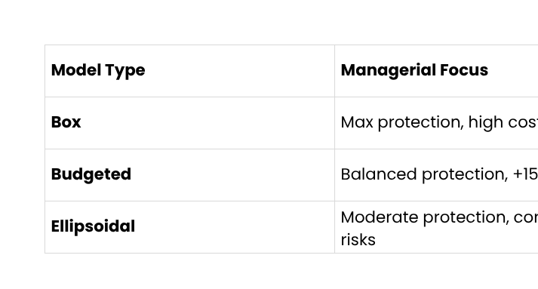

STRATEGIC SOURCING UNDER UNCERTAINTY
Robust Optimization – Managerial Control and Strategic Flexibility
1. Building Resilience through Robust Optimization
Models handle cost, demand, and lead-time uncertainty to ensure supply continuity and cost efficiency.
Enables managers to tune protection vs. cost trade-offs dynamically based on risk tolerance.
2. Operational Decision Support
Scenario-based planning: Forecast supplier performance under best/worst cases.
Negotiation leverage: Use cost-risk data for better contract structuring.
Risk mitigation: Prioritize reliable, stable suppliers (e.g., Guru Kripa Beej Bhandar, Maa Jai Ambe Agro).
Managers gain a quantitative toolkit to handle uncertainty, minimize disruptions, and ensure on-time, sustainable delivery.

Slide 27

STRATEGIC IMPLICATIONS & RECOMMENDATIONS
Managerial Actions for Long-Term Procurement Transformation
1. Strategic Value Creation
Sustainability Integration: Embedding ESG and tech-readiness ensures future-proof sourcing.
Resilience & Diversification: Budgeted and Ellipsoidal models reduce dependence on single suppliers.
Digital Enablement: Builds foundation for AI-driven, analytics-based procurement systems.
2. Managerial Recommendations
Institutionalize TOPSIS–DEMATEL scoring in supplier review dashboards.
Apply adaptive robust optimization with tunable parameters (Γ, ρ) for agile risk control.
Launch supplier upskilling in sustainability & technology integration.
Use Box model for high-risk markets, Budgeted for standard sourcing, and Ellipsoidal for mixed environments.
Form a cross-functional procurement governance team to interpret analytics and guide strategic sourcing.

Slide 28


THANK YOU.

